Slide 1
NCAA Basketball Regular Season Statistics
Jack Crum, Jiajia He, Qianyi Huang
Andrew Langsner, Tong Sun

Slide 2
Background
Why did we choose this dataset?
NCAA statistics: 74334 × 20 where the grain is one game and one team
Dimensions: Date, Team, Location, Conference, Outcome, Opponent
Measures: Overtimes, Field Goals, Free Throws, Rebounds, Turnovers, Personal Fouls

Slide 3
Data Definitions
Term | Definition
Season | The year in which the regular season ended.
Day number | An integer between 0 and 132 with zero being the 154 days before the final tournament game. 132 is selection Sunday.
teamID | A unique four digit identifier assigned to each team.
teamName | The name of each team in the for recorded by Kaggle in its 2017 March Madness Dataset.
Location | The location of the game relative to the teams location. (Home, Away, or Neutral)
gameOutcome | A win represents if the teams final score was greater than its opponents at the end of the game. Otherwise a loss. No ties.
Conference | Most teams belong to a conference. Blank teams are independent. Conference is officially recorded by the NCAA.
Opponent | The teamID of a team’s opponent in a particular game.
Points | The total number of points scored based on field goals, three pointers and free throws.
numOT | The number of overtimes in a particular game required to break ties.
fgMade | Number of two point shots made.
fgAttempts | Number of two point shots attempted.
fg3Made | Number of three point shots made.
fg3Attempts | Number of three point shots attempted.
ftMade | Number of free throws made.
ftAttempts | Number of free throw shots attempted.
offRebounds | Number off offensive rebounds defined as when a team retrieves the ball after a failed shot from the same team.
defRebounds | Number of defensive rebounds defined as when a team retrieves the ball after a failed shot by the opposing team.
Turnovers | When a team loses possession of the ball without making a shot.
pFoul | Personal foul, determined by the referee for a number of offenses.

Slide 4
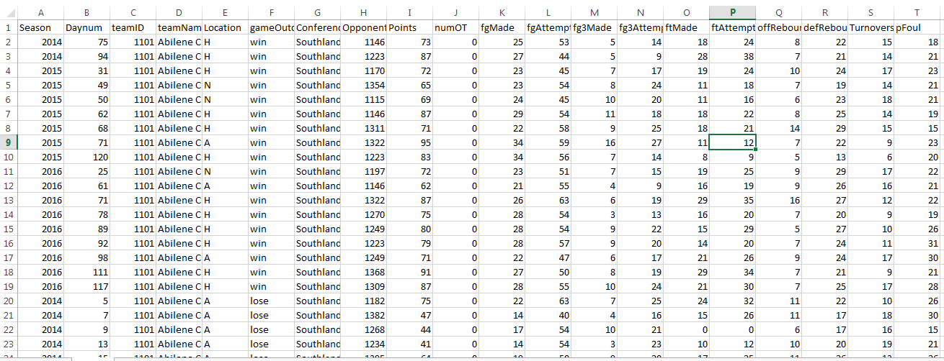
Dimensions
Measures

Slide 5
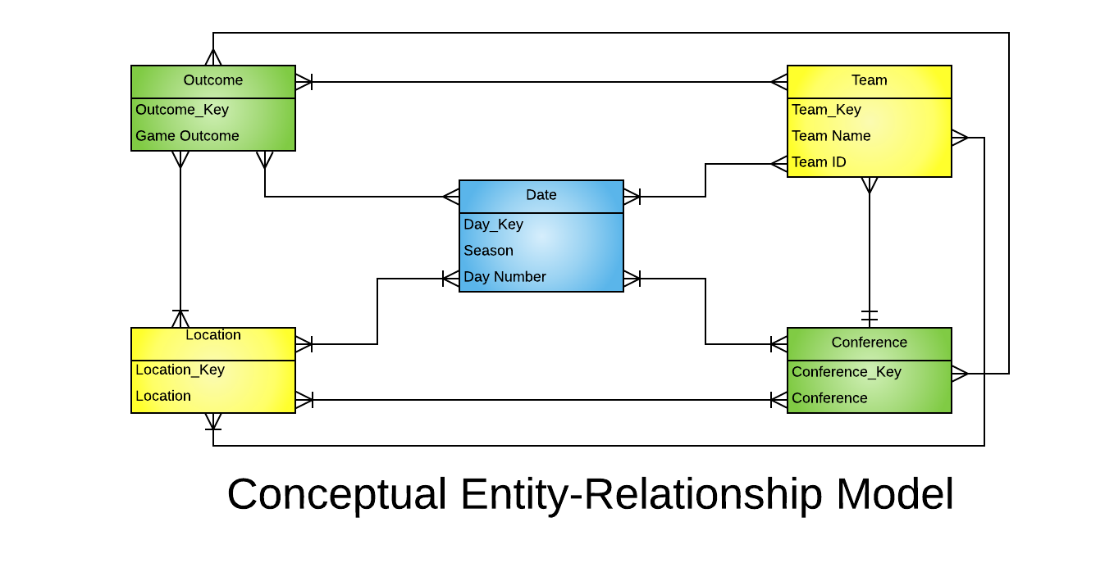
Conceptual Model

Slide 6
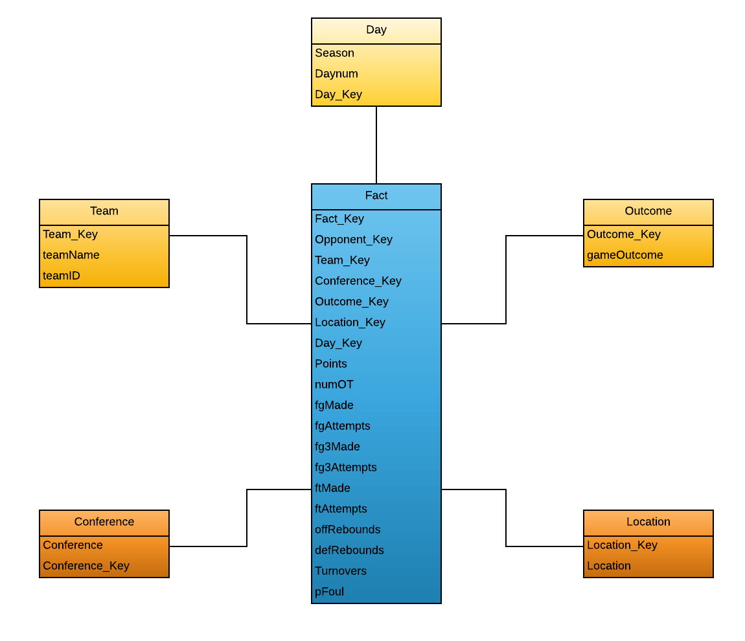
Dimensional Model
Grain
Each game played by a team.
Season, Day, Team ID

Slide 7
Data Quality Scorecard
Completeness | Metric Name | Target | Valid | Invalid | Score
 | Season | 100% | 74334 | 0 | 100
 | Daynum | 100% | 74334 | 0 | 100
 | teamID | 100% | 74334 | 0 | 100
 | teamName | 100% | 74334 | 0 | 100
 | Location | 100% | 74334 | 0 | 100
 | gameOutcome | 100% | 74334 | 0 | 100
 | Conference | 100% | 71232 | 3102 | 96
 | Opponent | 100% | 74334 | 0 | 100
 | Points | 100% | 74334 | 0 | 100
 | numOT | 100% | 74334 | 0 | 100
 | fgMade | 100% | 74334 | 0 | 100
 | fgAttempts | 100% | 74334 | 0 | 100
 | fg3Made | 100% | 74334 | 0 | 100
 | fg3Attempts | 100% | 74334 | 0 | 100
 | ftMade | 100% | 74334 | 0 | 100
 | ftAttempts | 100% | 74334 | 0 | 100
 | offRebounds | 100% | 74334 | 0 | 100
 | defRebounds | 100% | 74334 | 0 | 100
 | Turnovers | 100% | 74334 | 0 | 100
 | pFoul | 100% | 74334 | 0 | 100
Conformity | Metric Name | Target | Valid | Invalid | Score
 | Season | 100% | 74334 | 0 | 100
 | TeamID | 100% | 74334 | 0 | 100
 | Opponent | 100% | 74334 | 0 | 100
Timeliness | Metric Name | Target | Valid | Invalid | Score
 | N/A | N/A | N/A | N/A | N/A
Uniqueness | Metric Name | Target | Valid | Invalid | Score
 | Season, Day, teamID | 100% | 74334 | 0 | 100
Integrity | Metric Name | Target | Valid | Invalid | Score
 | Location | 100% | 74334 | 0 | 100
 | gameOutcome | 100% | 74334 | 0 | 100
Publication quality data studied by thousands of fans and sports statisticians.

Slide 8
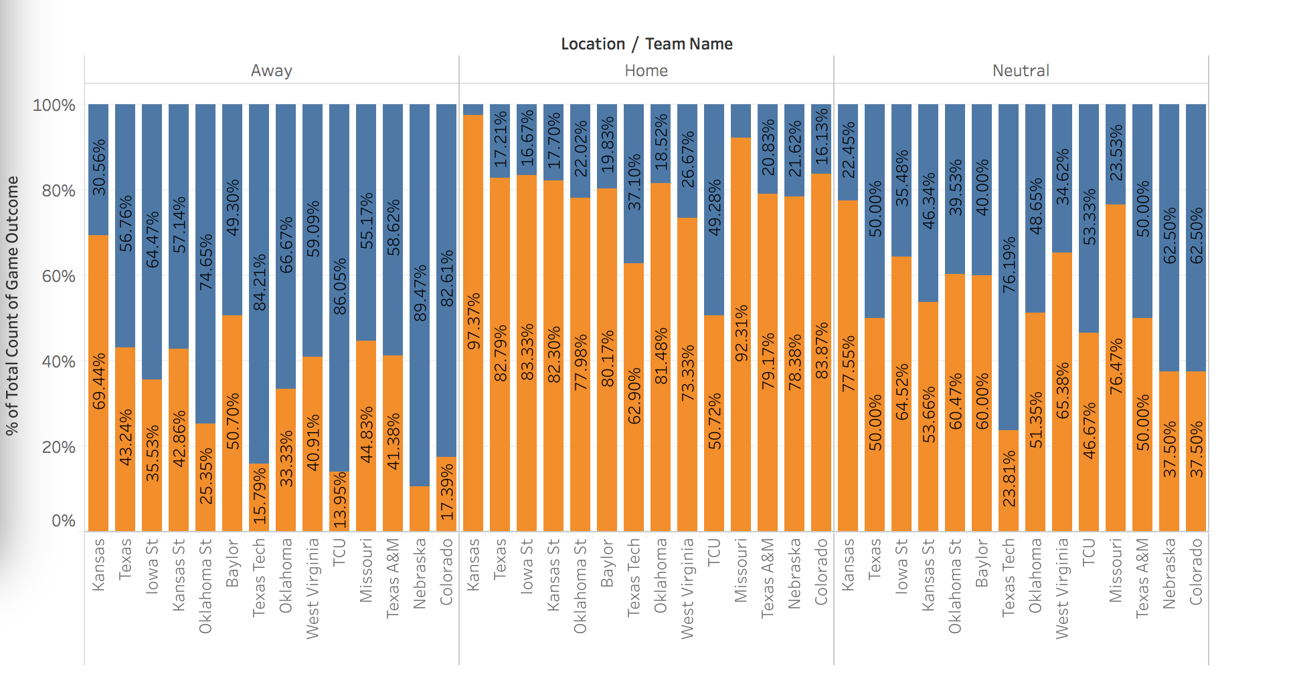
Data Visualization: Home vs. Away Games (Big 12 Conference)

Slide 9
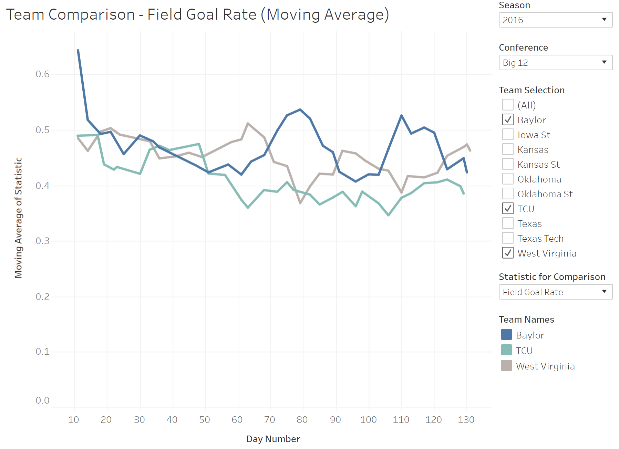
Data Visualizations: Dashboards
Tableau Dashboard

Slide 10
Questions and Comments?

